Slide 1
FOLK ART Recommendation System
Generative AI to produce folk art.

Slide 2


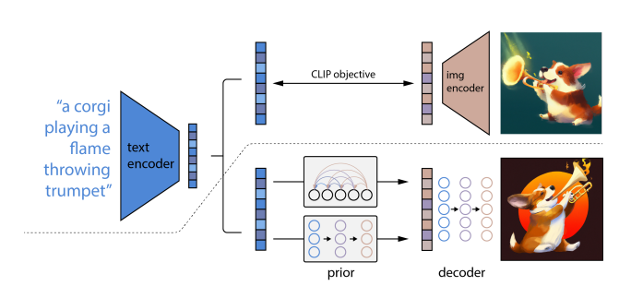
1. Intro
Approach to deal with
Text Data Large corpus of poems, text (Bengali Language)
Image Data Multiple images/paintings related to the text data.
Text2image, Image2image Training multimodal to generate relevant images.

Slide 3
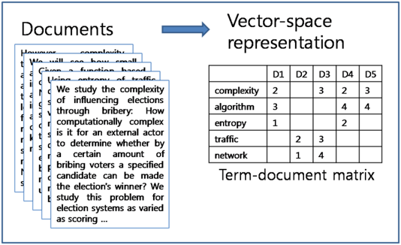
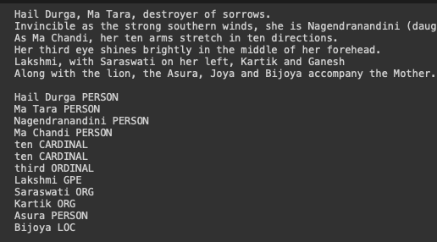
2. Text Data
Features extraction from text data:
Approaches:
Bag of words
TF-IDF
Word Embeddings
POS and NER
Feature extraction for finding the correlation between the text and the images and form a dataset which can be used to train a generative ai model.

Slide 4
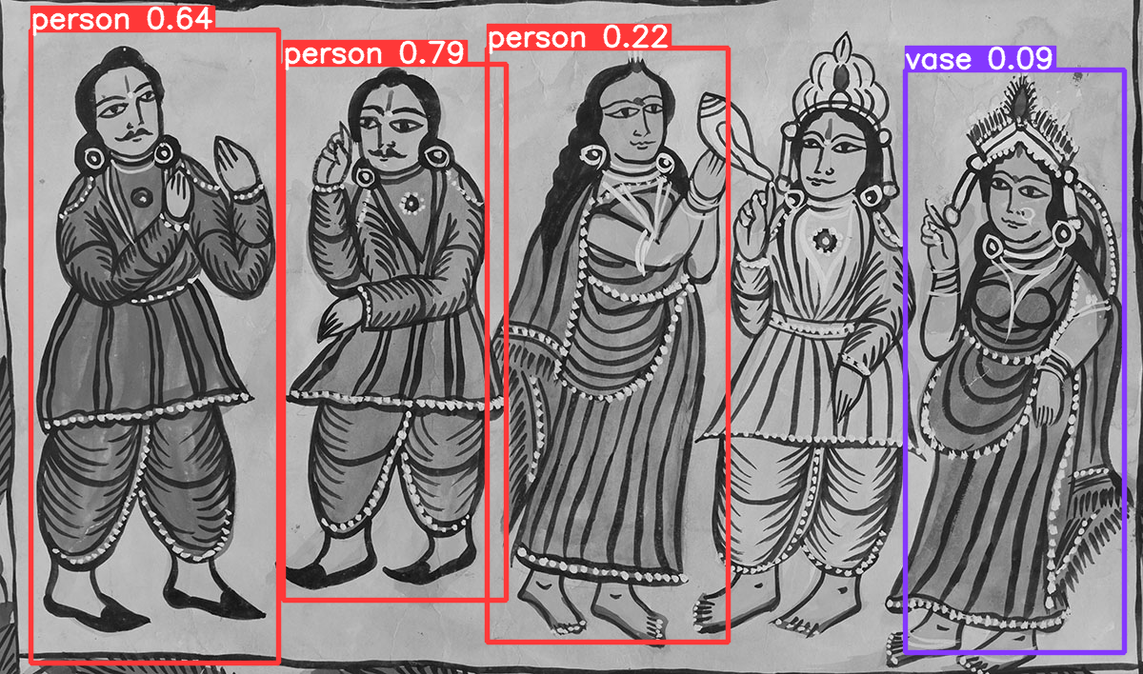
3. Image Dataset
Features extraction from Image data:
Approaches:
Object Detection Technique
Pre trained CNN
SIFT
Deep Visual Descriptors (e.g., DeepVLAD, NetVLAD)
Once we have the features from the images as well we can find the correlation to create multimodal text <–-> Image dataset to train our model.

Slide 5
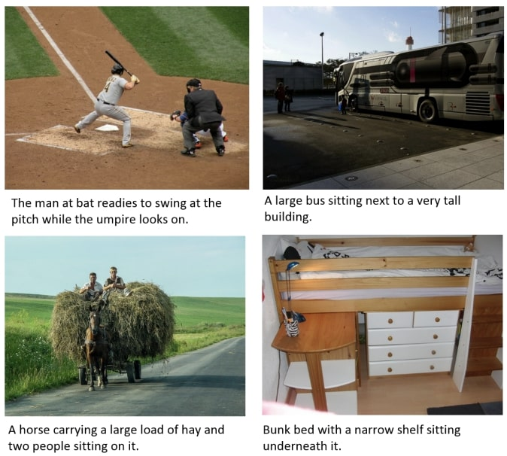
4. MultiModal Dataset
This is a tough task since the dataset is very unique and no available pre trained models are capable of captioning the images with the relevant text from the text dataset.
To create multimodal dataset we have to create small dataset first with manual labelling of key features in both text and image dataset.
Approaches:
Labelling text and image datasets.
Once we have small labelled dataset we can use following approaches for rest of the dataset:
Approaches:
Adversarial Training
Sampling/Ensemble Methods
Reinforcement Learning

Slide 6
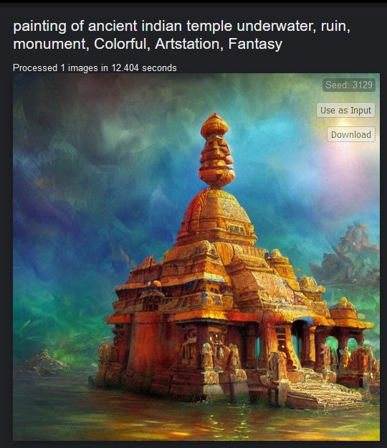
4. MultiModal Training
Approaches:
GAN
Variational Autoencoders (VAEs)
Text-to-Image Transformers
Stable Diffusion/Dall-E
Attention/Encoder-Decoder Mechanism
With the multimodal we can generate images or recommend images for the unseed datasets.

